Slide 1
Model
Evaluation

Slide 2
What is Model Evaluation?
Model evaluation is the process of using different evaluation metrics to understand a machine learning model’s performance, as well as its strengths and weaknesses. Model evaluation is important to assess the efficiency of a model during initial research phases, and it also plays a role in model monitoring.

Slide 3
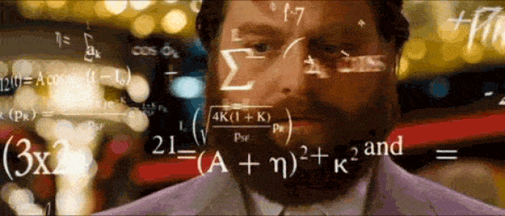
Why we need Model Evaluation?
It helps to find the best model that represents our data and how well the chosen model will work in the future.
Evaluating model performance with the data used for training is not acceptable in data science because it can easily generate over optimistic and overfitted models.

Slide 4
There are two methods of evaluating models in data science-
Hold-Out
Cross-Validation
To avoid overfitting, both methods use a test set (not seen by the model) to evaluate model performance.

Slide 5
Hold-Out
In this method, the mostly large dataset is randomly divided to three subsets:
Training set - It is a subset of the dataset used to build predictive models.
Validation set - It is a subset of the dataset used to assess the performance of model built in the training phase. It provides a test platform for fine tuning model's parameters and selecting the best-performing model. Not all modeling algorithms need a validation set.
Test set (unseen examples) - It is a subset of the dataset to assess the likely future performance of a model. If a model fit to the training set much better than it fits the test set, overfitting is probably the cause.

Slide 6
Cross Validation
When only a limited amount of data is available, to achieve an unbiased estimate of the model performance we use k-fold cross-validation. In k-fold cross-validation, we divide the data into k subsets of equal size. We build models k times, each time leaving out one of the subsets from training and use it as the test set. If k equals the sample size, this is called "leave-one-out".

Slide 7
Model evaluation can be divided to two sections:
Classification Evaluation
Regression Evaluation

Slide 8
Model Evaluation
For Classification

Slide 9
Different Model Evaluation
Accuracy Score
Precision score
Confusion matrix
Recall score
F1_score
Roc_auc curve

Slide 10
When to Use
It can be applied to most generic problems but is not very useful when it comes to unbalanced datasets.
For instance, if we are detecting frauds in bank data, the ratio of fraud to non-fraud cases can be 1:99. In such cases, if accuracy is used, the model will turn out to be 99% accurate by predicting all test cases as non-fraud. The 99% accurate model will be completely useless.

Slide 11
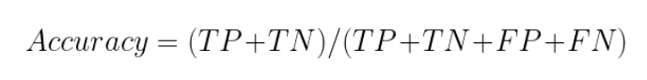
Accuracy Score
Definition -
Accuracy is a scoring system in binary classification (i.e., determining if an answer or returned information is correct or not). It measures how often the classifier makes the correct predictions, as it is the ratio. It sometimes used as an alternative to F-score.
Calculated as: (True Positives + True Negatives) / (True Positives + True Negatives + False Positives + False Negatives).

Slide 12
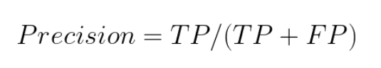
Precision Score
Definition -
Precision is the metric used to identify the correctness of classification.
Intuitively, this equation is the ratio of correct positive classifications to the total number of predicted positive classifications. The greater the fraction, the higher is the precision, which means better is the ability of the model to correctly classify the positive class.

Slide 13
When to Use
Precision is a good choice of evaluation metrics when you want to be very sure of your prediction.
In the problem of predictive maintenance (where one must predict in advance when a machine needs to be repaired), precision used. The cost of maintenance is usually high and thus, incorrect predictions can lead to a loss for the organisation. In these situations, it is crucial that the model correctly classifies the positive class and reduces the number of false positives.

Slide 14
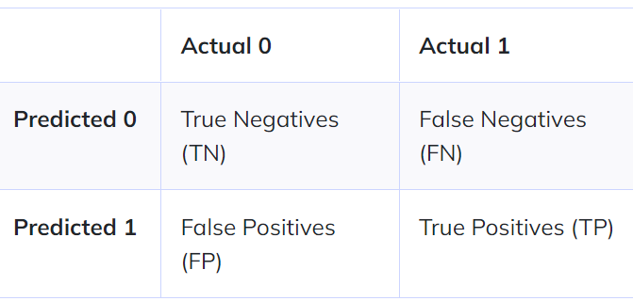
Confusion Matrix
Definition -
The confusion matrix (or confusion table) shows a more detailed breakdown of correct and incorrect classifications for each class.It can be constructed which demonstrates the number of test cases correctly and incorrectly classified.
It looks something like this (considering 1 -Positive and 0 -Negative are the target classes):
TN: Number of negative cases correctly classified
TP: Number of positive cases correctly classified
FN: Number of positive cases incorrectly classified as negative
FP: Number of negative cases correctly classified as positive

Slide 15
When to Use
Using a confusion matrix is useful when you want to understand the distinction between classes, particularly when the cost of misclassification might differ for the two classes, or you have a lot more test data on one class than the other. For example, the consequences of making a false positive or false negative in a cancer diagnosis are very different.

Slide 16
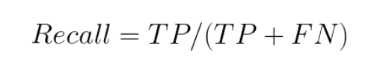
Recall Score
Definition -
Recall tells us the number of positive cases correctly identified out of the total number of positive cases.
Recall-Evaluation method is
a) defined as the fraction of positive cases that are correctly identified. b) defined as the percentage of true positive cases versus all the cases where the prediction is true.
c) defined as the percentage of correct predictions out of all the observations.
d) comparison between the prediction and reality.

Slide 17
When to Use
Recall is very used when you have to correctly classify some event that has already occurred. For example, fraud detection models must have a high recall in order to detect frauds properly. In such situations, we don’t care about the real 0s, because we are interested only in spotting the real 1s as often as possible. So, we’re working with the second row of the confusion matrix.
Common uses of recall are as fraud detection models or even disease detection on a patient. If somebody is ill, we need to spot their illness avoiding the false negatives. A false negative patient may become contagious and it’s not safe. That’s why, when we have to spot an event that already occurred, we need to work with recall.

Slide 18
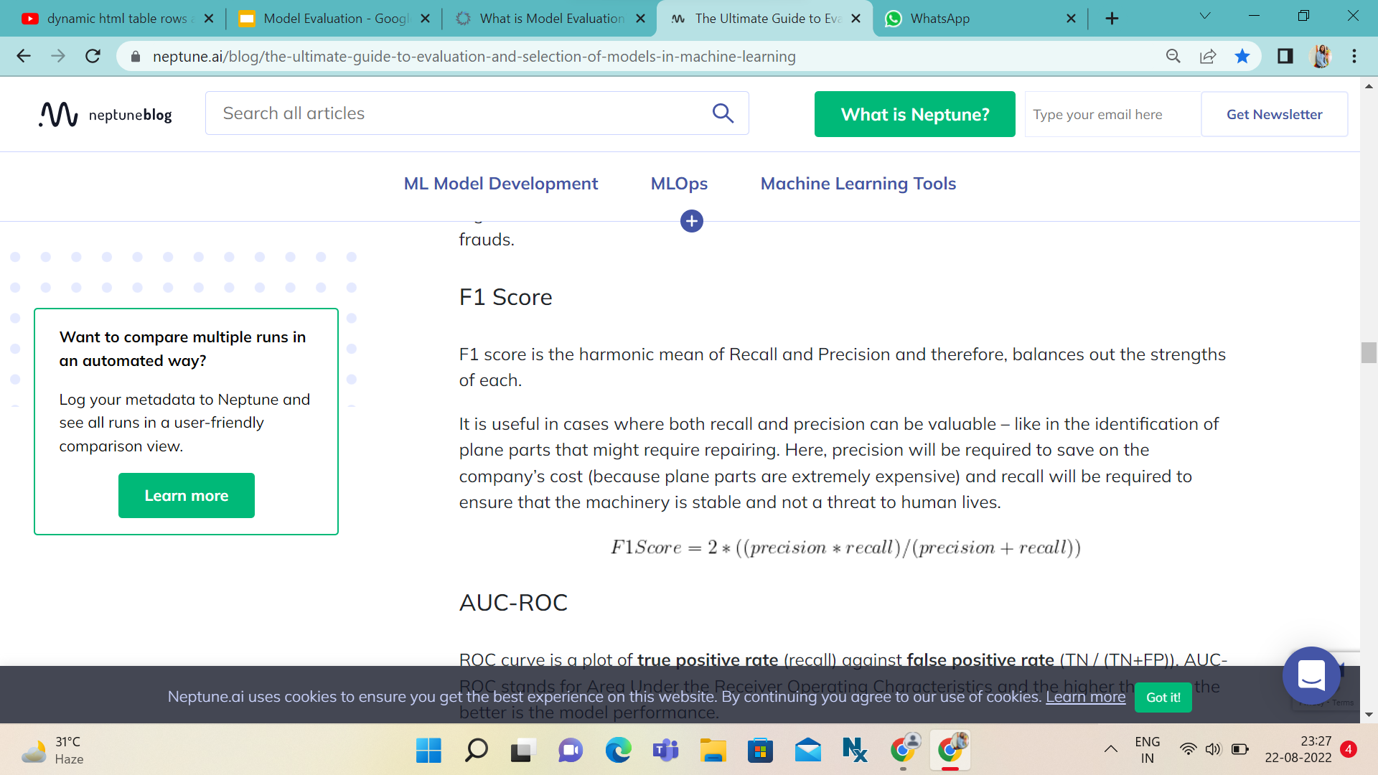
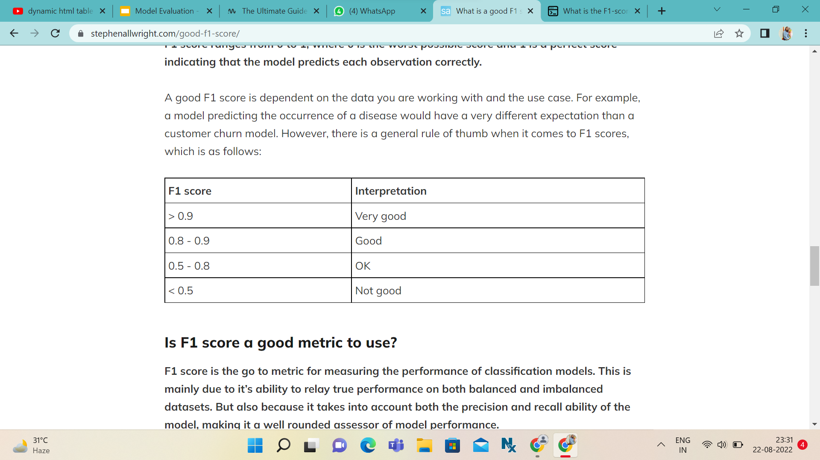
F1_Score
Definition -
An F-score is the harmonic mean of Precision and Recall values of a system.
Calculated as -

Slide 19
When to Use
It is useful in cases where both recall and precision can be valuable. It is primarily used to compare the performance of two classifiers. Suppose that classifier A has a higher recall, and classifier B has higher precision. In this case, the F1-scores for both the classifiers can be used to determine which one produces better results.

Slide 20
ROC AUC Curve
Definition -
An ROC curve (receiver operating characteristic curve) is a graph showing the performance of a classification model at all classification thresholds. This curve plots two parameters:
True Positive Rate
False Positive Rate
True Positive Rate (TPR) is a synonym for recall and is therefore defined as follows:
TPR=TP/TP+FN
False Positive Rate (FPR) is defined as follows:
FPR=FP/FP+TN

Slide 21
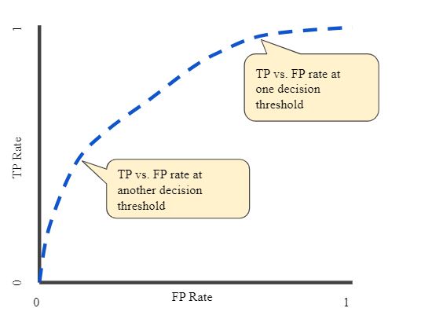
An ROC curve plots TPR vs. FPR at different classification thresholds. Lowering the classification threshold classifies more items as
positive, thus increasing both False Positives and True Positives.
The following figure shows a typical ROC curve.

Slide 22
AUC: Area Under the ROC Curve
AUC stands for "Area under the ROC Curve." That is, AUC measures the entire two-dimensional area underneath the entire ROC curve (think integral calculus) from (0,0) to (1,1).
AUC provides an aggregate measure of performance across all possible classification thresholds. One way of interpreting AUC is as the probability that the model ranks a random positive example more highly than a random negative example.

Slide 23
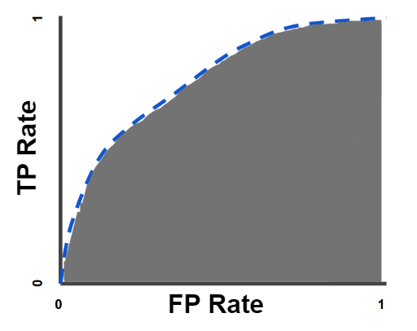
AUC Curve

Slide 24
When To Use AUC Curve
AUC is desirable for the following two reasons:
AUC is scale-invariant. It measures how well predictions are ranked, rather than their absolute values.
AUC is classification-threshold-invariant. It measures the quality of the model's predictions irrespective of what classification threshold is chosen.

Slide 25
Model Evaluation For Regression

Slide 26
Different Model Evaluation
MAE
MSE
RMSE
R squared
Adjusted R squared

Slide 27
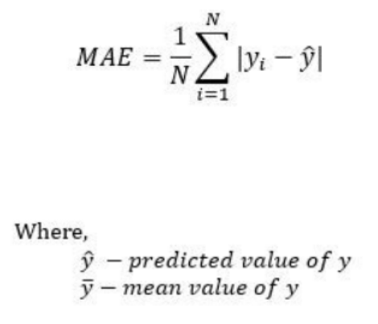
MAE (Mean Absolute Error)
Definition -
The Mean absolute error represents the average of the absolute difference between the actual and predicted values in the dataset. It measures the average of the residuals in the dataset.

Slide 28
Short Notes-
Residuals ("leftovers") represent the variation that a given model, uni- or multivariate, cannot explain (Figure 1). In other words, residuals represent the difference between the predicted value of a response variable (derived from some model) and the observed value.
When to Use -
When a dataset has a large number of outlier cases, it is sometimes employed as an alternative to the MSE.

Slide 29
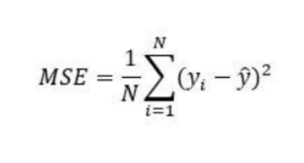
MSE (Mean Squared Error)
Definition -
Mean Squared Error represents the average of the squared difference between the original and predicted values in the data set. It measures the variance of the residuals.
MSE is a differentiable function that makes it easy to perform mathematical operations in comparison to a non-differentiable function like MAE.

Slide 30
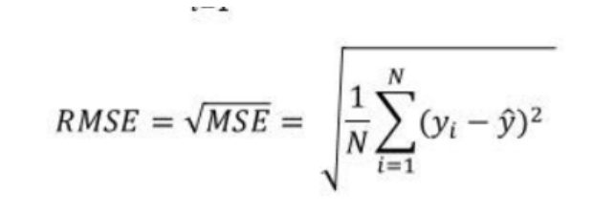
RMSE (Root Mean Squared Error)
Definition -
Root Mean Squared Error is the square root of Mean Squared error. It measures the standard deviation of residuals.
RMSE is widely used than MSE to evaluate the performance of the regression model with other random models as it has the same units as the dependent variable (Y-axis).
For comparing the accuracy among different
linear regression models, RMSE is a better
choice than R Squared.

Slide 31
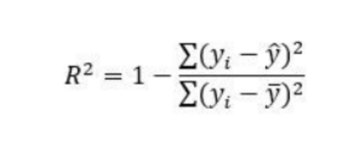
R Squared
Definition -
R-squared represents the proportion of the variance in the dependent variable which is explained by the linear regression model. It is a scale-free score i.e. irrespective of the values being small or large, the value of R square will be less than one.

Slide 32
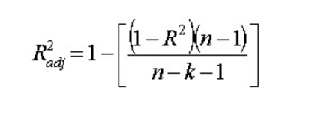
Adjusted R Squared
Definition -
Adjusted R squared is a modified version of R square, and it is adjusted for the number of independent variables in the model, and it will always be less than or equal to R².
In the formula, n is the number of observations in the data and k is the number of the independent variables in the data.

Slide 33
Few Facts To Remember
R Squared & Adjusted R Squared are used for explaining how well the independent variables in the linear regression model explains the variability in the dependent variable. R Squared value always increases with the addition of the independent variables which might lead to the addition of the redundant variables in our model. However, the adjusted R-squared solves this problem.
Adjusted R squared takes into account the number of predictor variables, and it is used to determine the number of independent variables in our model. The value of Adjusted R squared decreases if the increase in the R square by the additional variable isn’t significant enough.
The lower value of MAE, MSE, and RMSE implies higher accuracy of a regression model. However, a higher value of R square is considered desirable.

Slide 34
Thank You

